Slide 1
PREDICTING CROSS- SELLING IN HEALTH INSURANCE

Slide 2

INTRODUCTION
Building a model to predict whether a customer would be interested in Vehicle Insurance is extremely helpful for the company because it can then accordingly plan its communication strategy to reach out to those customers and optimise its business model and revenue.
Now, in order to predict, whether the customer would be interested in Vehicle insurance, you have information about demographics (gender, age, region code type), Vehicles (Vehicle Age, Damage), Policy (Premium, sourcing channel) etc.

Slide 3

Observation from General overview of Dataset 1.There are 381109 rows and 12 columns in dataset. 2.There is no null/missing and no duplicate values found. 3.There are 3 columns with Object Dtype and 9 with int64 Dtype. 4.The customers age ranges from 20 to 85, however the 75% of the customer is in range of 20 to 49 years. 5.Annual Premium ranges from 2630 to 540165, however the 75% of customer is in range of 2630 to 39400. 6.Id, Age, Annual_premium ,Annual_Premium, Policy_Sales_Channel ,Vintage, Region_Code feature is of numerical types and rest all are of the categorical types.

Slide 4
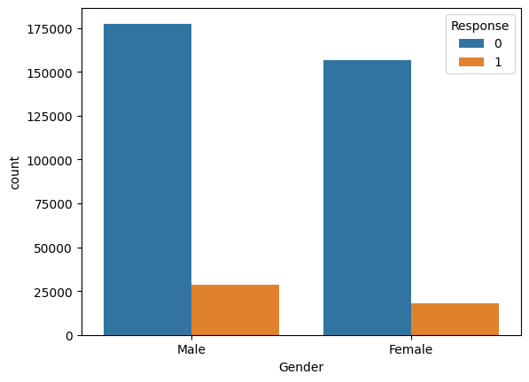
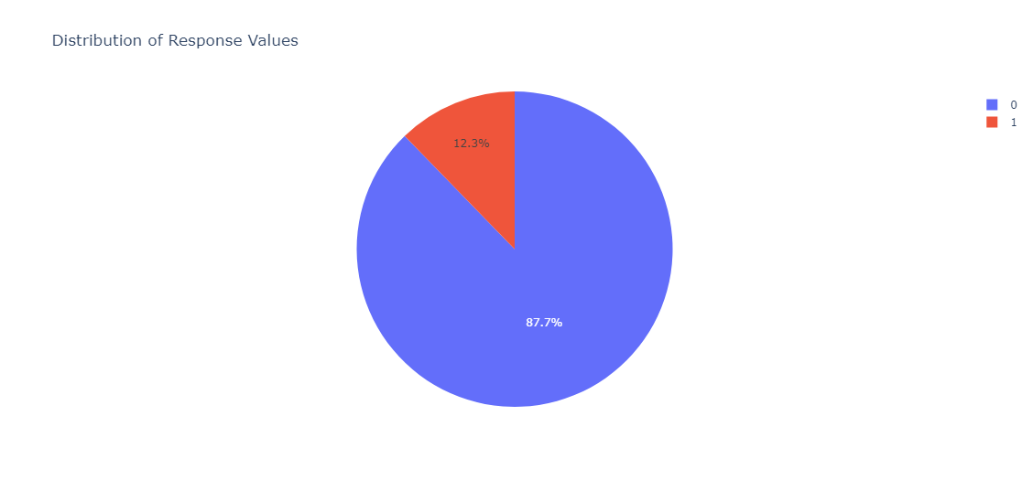

Slide 5
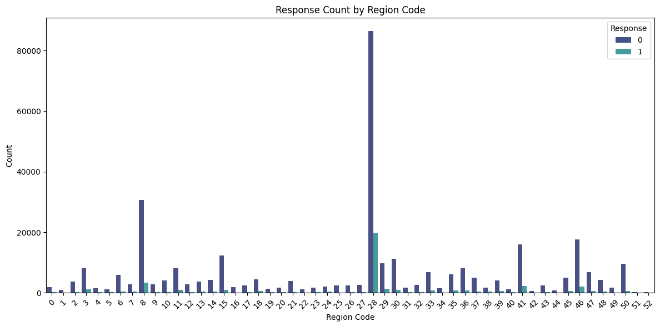
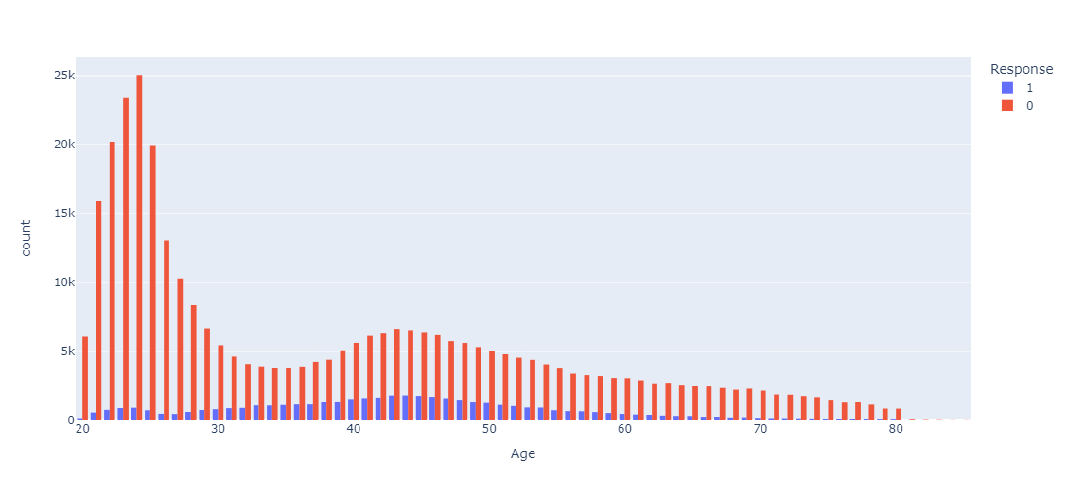
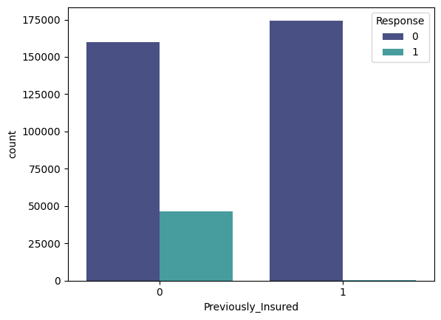
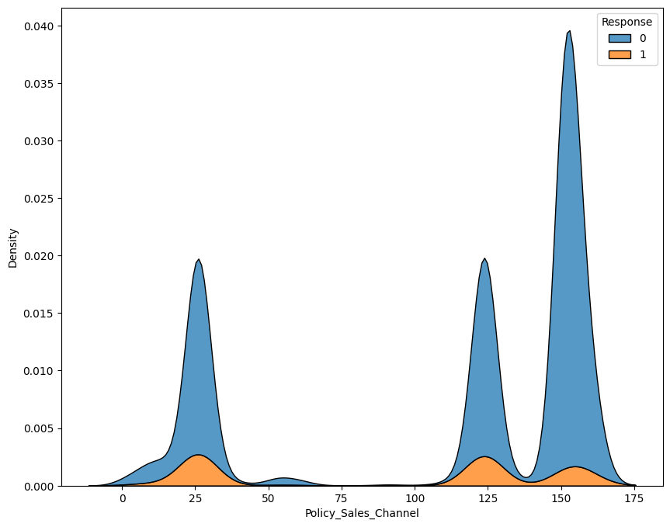

Slide 6
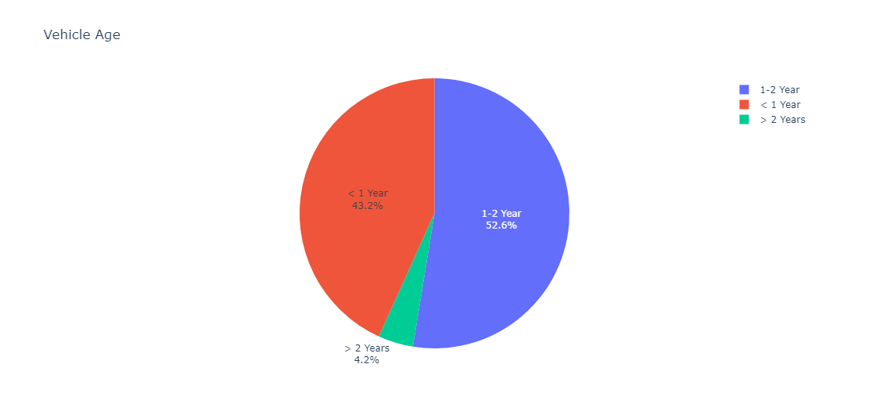
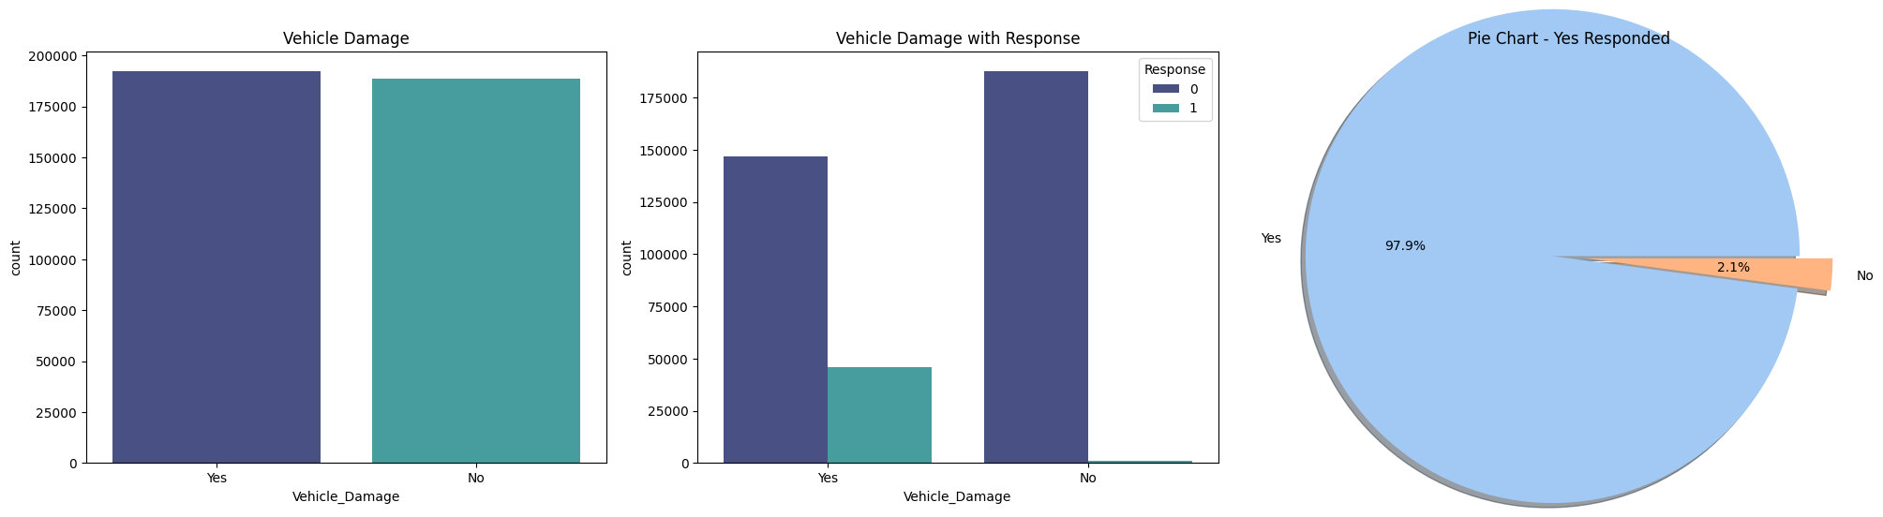

Slide 7
Overall Observation from EDA: The dataset is unbalanced, having only 12.26 % of customer are interested in vehicle insurance. The age group between 40-50 are showing more interest in vehicle insurance than the other age groups which might for segment the customer. only 41 person out of total who showed interest does not driving license. out of total 53 region, region having Region_Code 28 has the maximum number of customer which is equal to 106415. And 19917 of these customers responded positively. Customers who have not taken vehicle insurance previously are more interested in taking the vehicle_insurance. Approximately 74.5% of people who responded positively have vehicle age in between 1-2 years. the top 3 policy_sales_channel who contacted most of the customers are 152,26,54 and the top 3 through which maximum positive response were observed are 26,124,152. The median age of people not having driving license is approximately 65 but approximately 30 for people having driving license. From Customer who responded positively, The median age is approximately 55 for customer having no license and approximately 40 for having license.

Slide 8
In this section we will train six models, these are (1) Logistic regression (2) Multinomial Naive Bayes (3) Decision Tree Classifier (4) Random Forest Classifier (5) xgboost
Evaluation Metrics: (1) roc_auc :Recievers operating characteristics area under curve (2) precison : ratio of true positive to sum of false positive and true positive which represents that out of total positive points model is predicting how many of them are actually positive. (3) Recall : ratio of true positive to the total positive (actual). (4) accuracy : ratio of true prediction by total values.

Slide 9
CONCLUSION
For determining the cross sell Prediction we started with the exploratory data analysis , data transformation, and then model training. The following conclusion were made from this project is:
The features like driving_license, previously_insured, vehicle age of particular category were found common in customers who responded positively. Like (customers having driving license, not previously_insured, vehicle age in 1-2 years are responded positively about vehicle_insurance)
There are few policy_sales_channel (26,124,52) and Region_code (28,8,46) have many positive respondent and most of other have very few.
From model training:
The best performing model is RandomForestClassifier with hyperparameters (max_depth = 10, n_estimators = 200, min_samples_split = 100). Although the train score of all the models are almost similar but test score observe was best for RandomForest classifier.
Random Forest predicts : out of total 195381 total test points, the 153279 predicted value are true making the accuracy of 78.45% with precision of 71.6.

Slide 10

Thanks!
Do you have any questions? Sumant Kale
+919637537570

